Slide 1
Models results on hyper-spectral image and thermal image from corn field on ‘Newe Yaar’ (30.09.25_
Dataset name: hs_and_th_imgs_dataset_NeweYaar__20250930_2025-11-11 11.csv

Slide 2
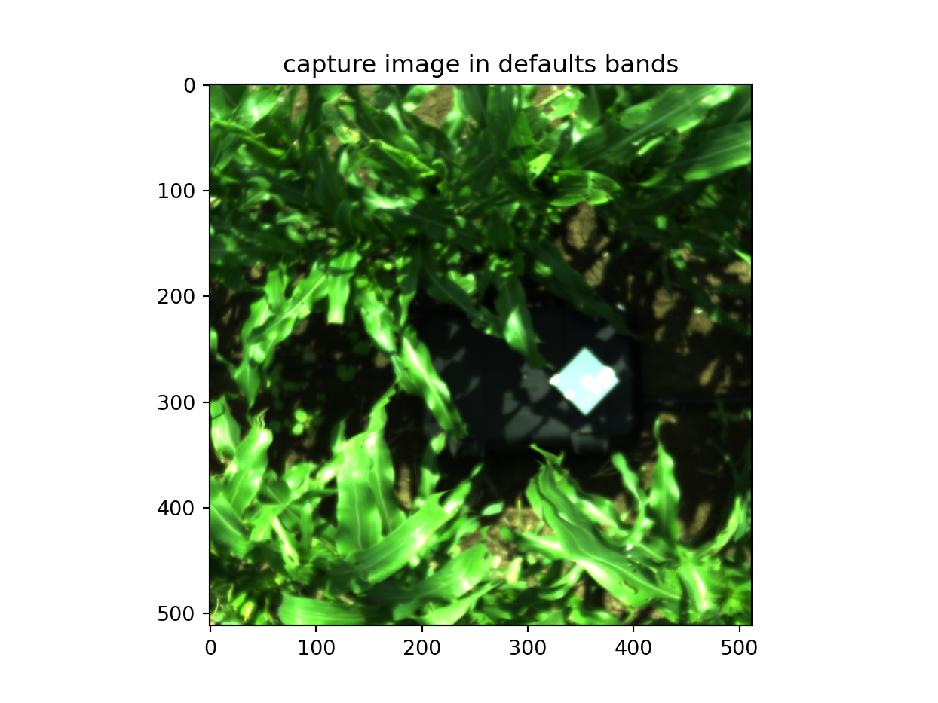
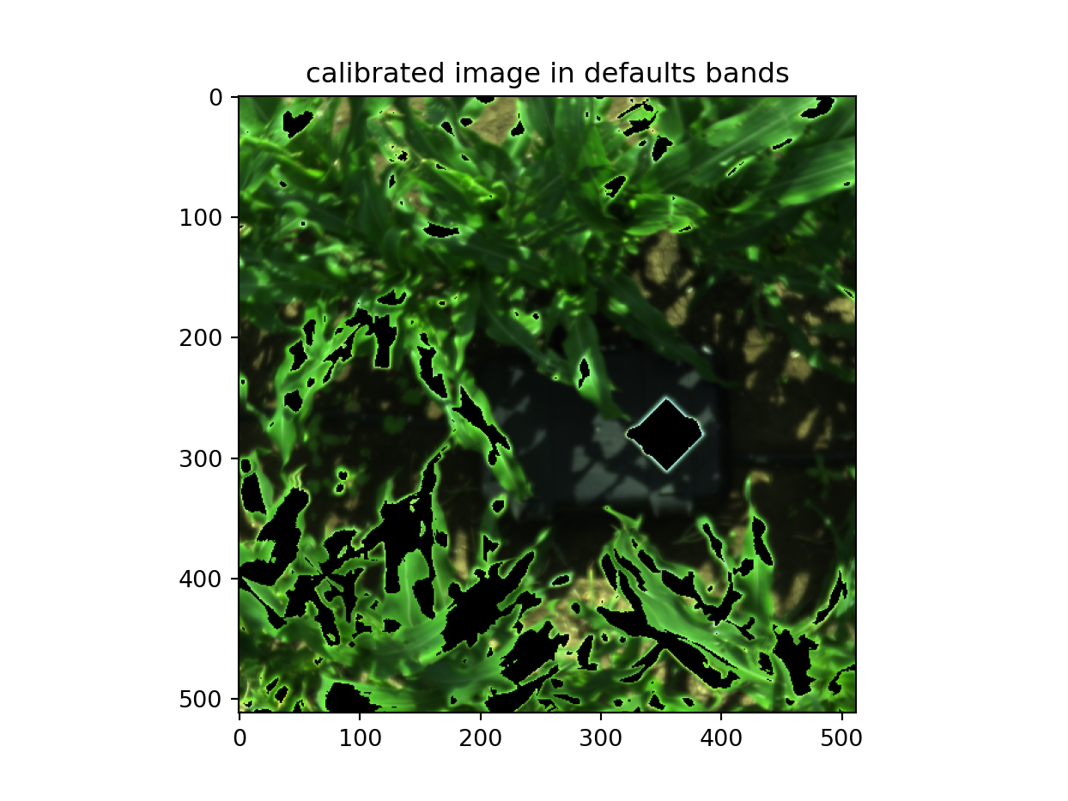
Hyper-Spectral images: We noticed that the rendered of the capture images and the calibrated image is different. For Example look On image 103 differences . It is quite clear that the calibrated image convert to black (0) more pixels than the captured image. That mean the threshold for saturation in the calibrated image is lower then the threshold of the captured image (4095)

Slide 3
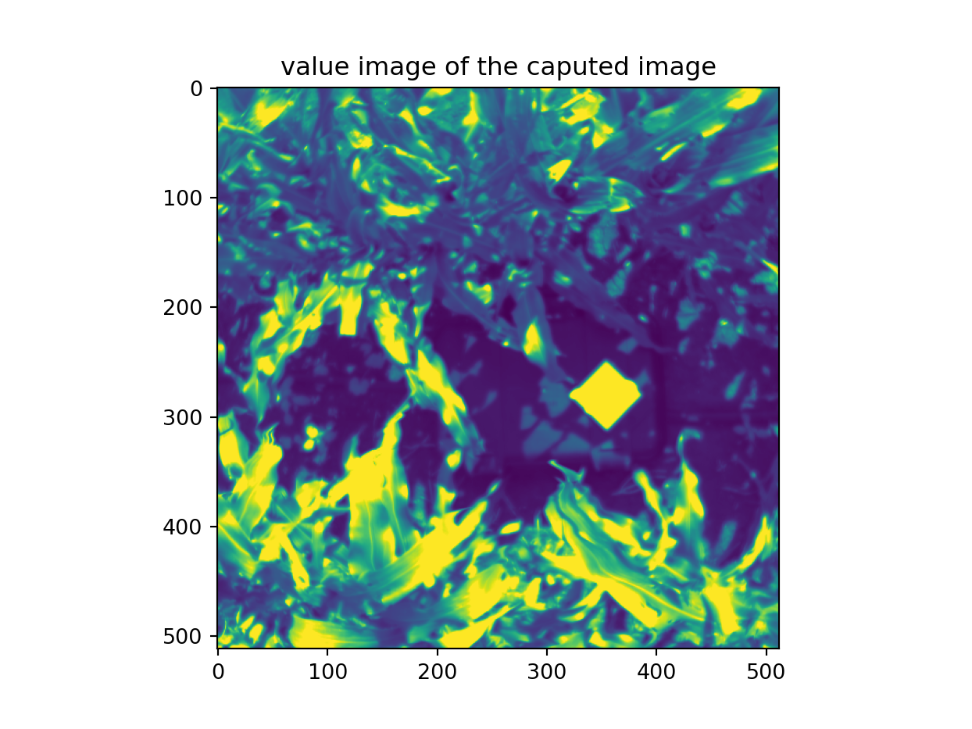
Hyper-Spectral images: It seems the view-render convert to black the pixel of calibrated image where in the captured image their value is 1.

Slide 4
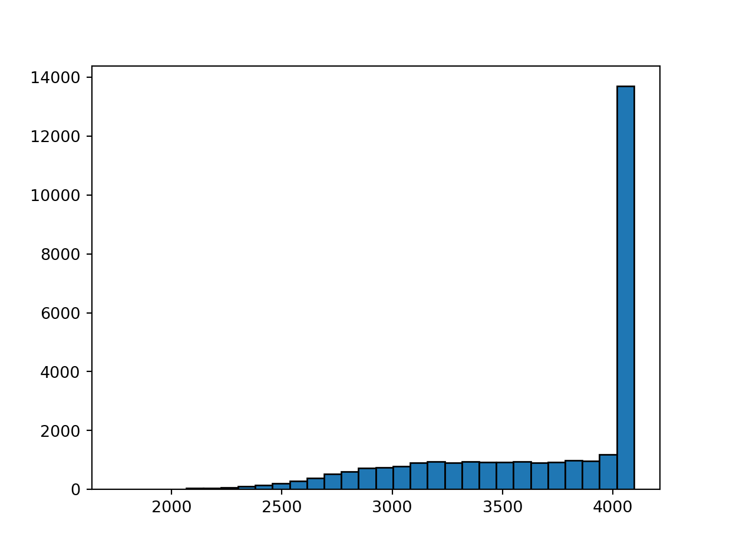
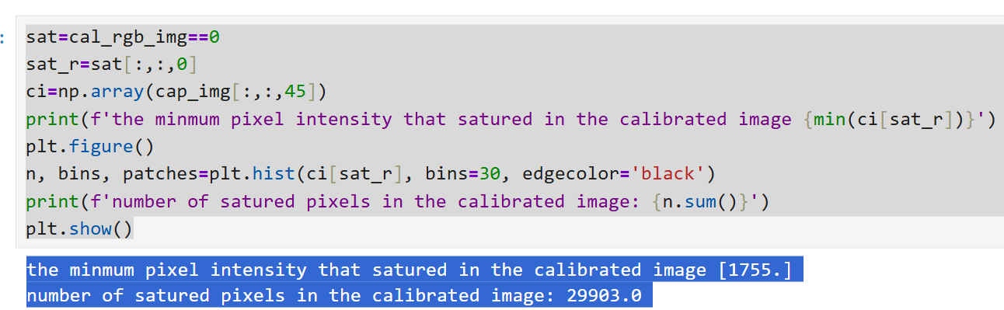
It turn out that in the calibrated image the pixel ‘statured’ (namely converted to black) even for intensity lower as 1755. The histogram below is for the calibrated image presented below. It show the count of the black pixel for each bin where the y-axis is the intensity of the sensor.

